Slide 1
Winged Adventure: Flappy Bird
Abhishek Kumar (12112336) RK21STA32

Slide 2
INTRODUCTION
FOR PROJECT WE HAVE MADE ONE OF THE MOST POPULAR GAME FLAPPY BIRD. WHICH INCLUDE DIFFERENT FEATURES FOR SMOOTH AND INTERATIVE GAME PLAY.TO BUILD THIS GAME. IT’S A GUI-BASED PROJECT USED WITH THE SWING LIBRARY TO ORGANIZE ALL THE ELEMENTS THAT WORK UNDER THE FLAPPY BIRD GAME. I USED OBJECT-ORIENTED PROGRAMMING PRINCIPLES AND VARIOUS JAVA LIBRARIES TO CREATE THE GRAPHICS, SOUND, AND USER INTERFACE. I ALSO IMPLEMENTED AN EFFICIENT COLLISION DETECTION ALGORITHM TO ENSURE ACCURATE GAMEPLAY AND PREVENT CHEATING .IN ADDITION TO THE CORE GAMEPLAY, I'VE ADDED FEATURES SUCH AS SCORING, HIGH SCORE TRACKING, AND AN APPEALING VISUAL DESIGN.

Slide 3
LEARNING OUTCOMES
BY BUILDING THIS GAME THE DEVELOPER TO ACHIVE THE FOLLOWING OUTCOMES:
Enhance Programming Skills: Building a game like Flappy Bird requires a strong understanding of programming concepts, including object-oriented programming, data structures, and algorithms. Developing this game can help developers improve their programming skills and gain hands-on experience with complex game mechanics.
Improve Problem-Solving Skills: Developing a game requires developers to solve various problems, such as implementing collision detection, designing game levels, and optimizing performance. By building Flappy Bird, developers can improve their problem-solving skills and gain experience in addressing complex challenges.
Boost Creativity: Game development allows developers to express their creativity by designing engaging game mechanics, creating captivating graphics, and composing soundtracks. By building Flappy Bird, developers can exercise their creativity and experiment with new ideas to create a unique and enjoyable gaming experience.
Learn New Technologies: Building a game like Flappy Bird requires knowledge of various technologies, including game engines, programming languages, and graphics libraries. Developers can use this project as an opportunity to learn new technologies and explore the latest trends in game development.
Gain Experience in Game Development: Developing a game requires developers to understand the entire game development process, from designing the user interface to testing and debugging. Building Flappy Bird can give developers hands-on experience in game development, which can help them pursue a career in this exciting field.

Slide 4
ABOUT TECHNOLOGY USED
1) LANGUAGE: JAVA
Java is a versatile and powerful programming language that can be used for a wide range of applications, from desktop software to enterprise systems. Its portability, security, and object-oriented design make it a popular choice among developers.
2) GUI TOOLKIT: JAVA SWING
Java Swing is a powerful and flexible GUI toolkit that provides a wide range of components and tools for building desktop applications with a graphical interface. Its cross-platform compatibility and customization options make it a popular choice among developers who want to create rich and interactive user interfaces for their applications.
3) IDE: VISUAL STUDIO CODE
VS Code is a powerful and highly customizable code editor that supports a wide range of programming languages and frameworks. Its extensibility, productivity features, and Git integration make it a popular choice among developers who want a fast and efficient development environment.

Slide 5
GAME PLAY
Our Flappy Bird game begins with a start screen that displays the title of the game and instructions on how to play. Once the player starts the game, they control a bird that must navigate through a series of pipes without touching them.
The player can make the bird flap its wings by pressing the spacebar or clicking the mouse. Each successful pass through a pipe earns the player one point. The game ends when the bird collides with a pipe or hits the ground.
If the players bird collides with the pipes it will be redirected to the start windows and his last played score is highest then the already stored highest score then it will be updated.

Slide 6
FEATURES
Simple Gameplay: Flappy Bird Has A Straightforward Gameplay Mechanic Where The Player Controls A Bird And Must Navigate It Through A Series Of Obstacles By Tapping The Screen To Make The Bird Flap Its Wings.
Scoring System: The Game Keeps Track Of The Player's Score Based On How Far They Can Travel Through The Level Before Colliding With An Obstacle.
Retro Graphics: Flappy Bird Features Simple 2d Graphics That Are Reminiscent Of Classic Arcade Games, Which Adds To Its Nostalgic Appeal.

Slide 7
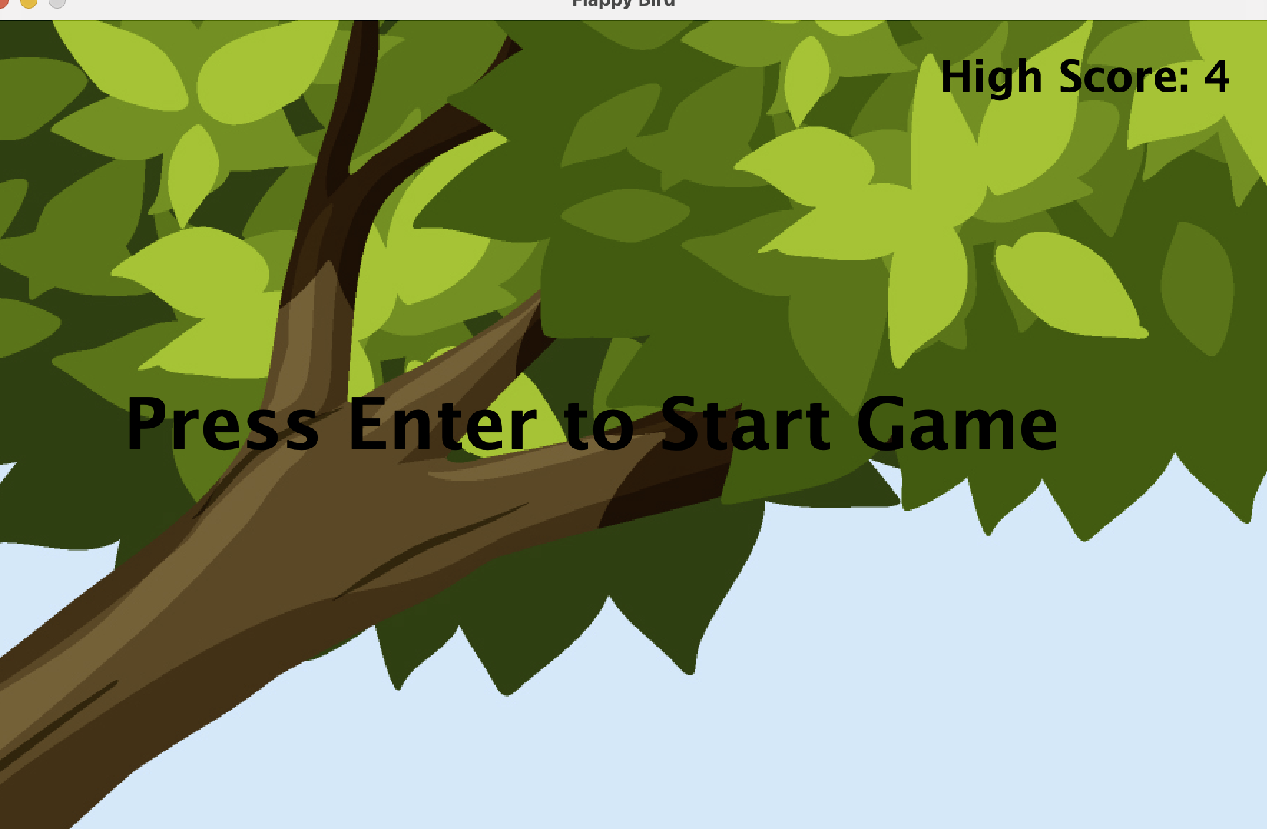
CODE SAMPLES AND OUTPUT
// Method used to move the bird
public void tick() {
if(dy < 5) { // If the speed of the bird is less than 5
dy += 2; // Increase the speed of the bird
}
this.y += dy; // Move the bird down the screen
tube[0].tick(); // Move the wall down the screen
checkWindowBorder(); // Check if the bird has hit the top or bottom of the screen
}
public void jump() {
if(dy > 0) { // If the speed of the bird is greater than 0
dy = 0; // Set the speed of the bird to 0
}
dy -= 15; // Move the bird up the screen
}

